Slide 1
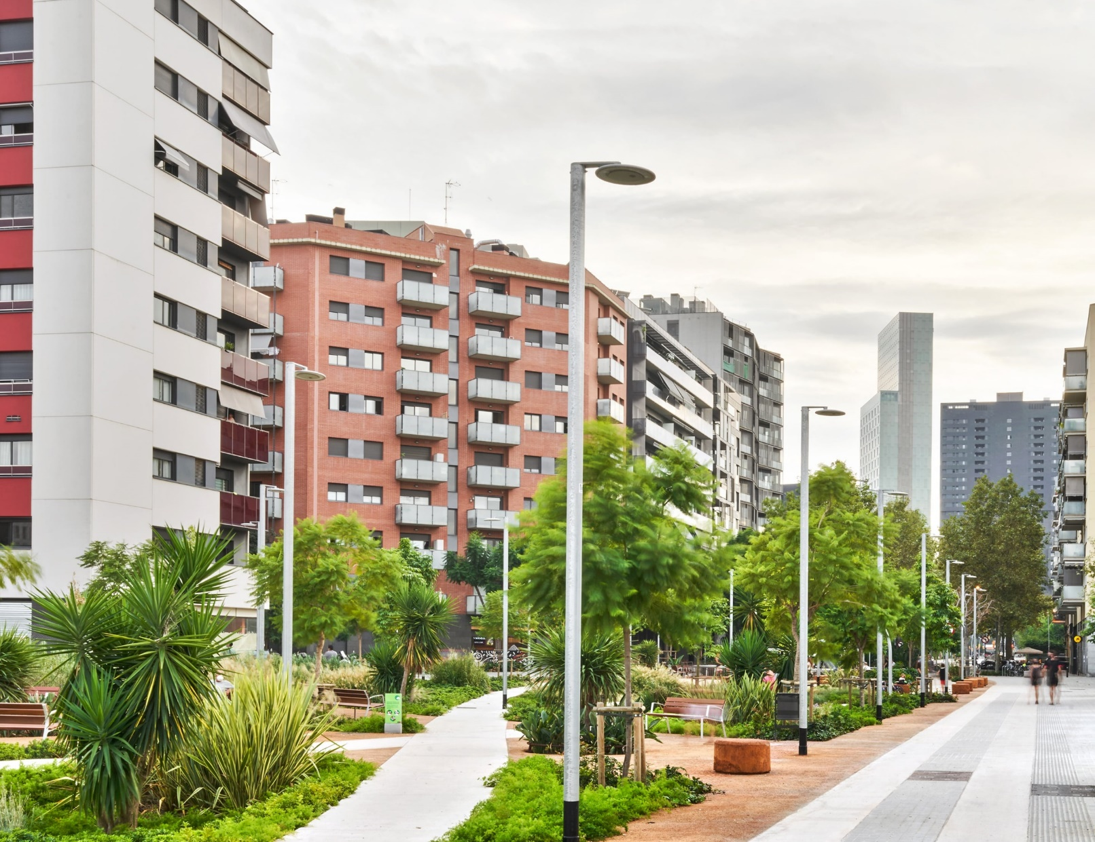
New
European
Bauhaus
What you need to know
Haroun Khalid
DG REGIO - E.3

Slide 2
01
02
03
AGENDA
04
05
ABOUT THE NEB
PRINCIPLES AND OBJECTIVES
POLICY CONTEXT
NEXT STEPS
QUESTIONS

Slide 3
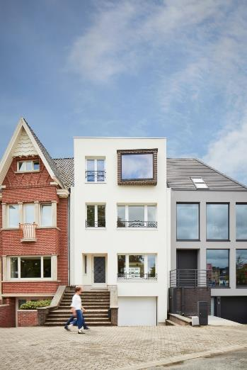
The basics
Initiative to marry environmental sustainability to social inclusiveness and a commitment to improving quality of life.
Can be thought of as the cultural dimension to the European Green Deal.
Aims to create space for experimentation and a platform for knowledge sharing.
Overarching objective is to identify a set of best practices, to develop a ‘toolbox’ for sustainable, inclusive, and beautiful development.
Woning KAP, Kortrijk

Slide 4
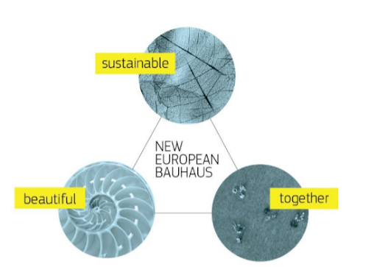
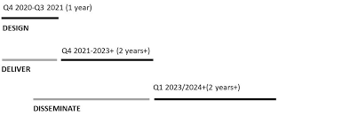
Who / What / When
The New European Bauhaus initiative is a network 350+ official partners, representing diverse stakeholders, from government to civil society, citizens’ initiatives, and companies.
The main is to embody the ‘design for everyone’ principle, and ensure that the benefits of the digital and green transitions are shared broadly.
The NEB Lab:
A grounds for experimentation, where projects can be evaluated and modified, innovative funding mechanisms can be assessed, policies trialled, and new technologies tested.

Slide 5
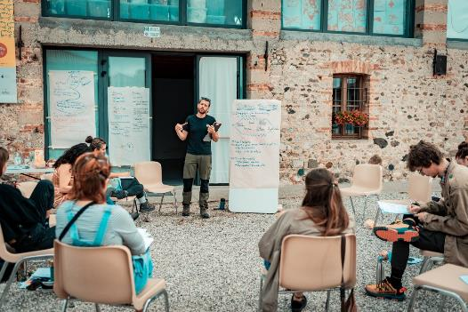
An ethos of development
Not a rigid project or programme, but rather a way of programming that integrates the values of sustainability, inclusivity, and aesthetics into all facets of development.
A process of development that is participatory, transdisciplinary, and multilevel.
Zero waste house, Žalec

Slide 6
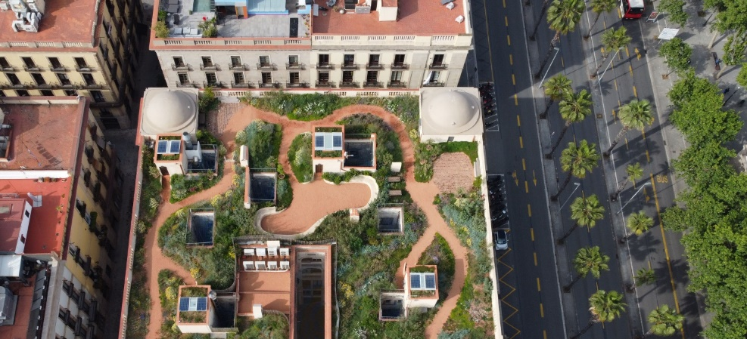

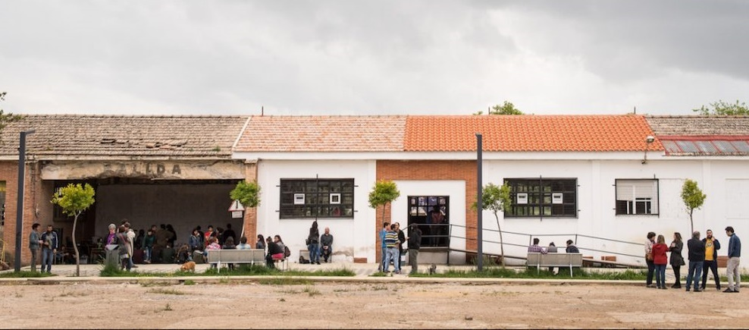
Tangible goals
New European Bauhaus areas of action
Intangible goals
Techo de Xifré, Barcelona
Support for tangible projects on the ground, including:
Funding pilot projects and demonstrators
Dedicated calls for submissions
Scaling up successful ideas
Bauhaus festival and prizes
Bauhaus label
A broad shift in the culture of design and development, to see the integration of multilevel participation, sustainability, and quality of life outcomes embedded into regular programming.
LaFábrika detodalavida, Extremadura

Slide 7
Core values
Aesthetics
Sustainability
Inclusivity

Slide 8
Core values
Aesthetics
Sustainability
  Circular economy
  Energy efficiency
  Use of sustainable materials and construction techniques
  Re-use of materials and spaces
  Green mobility
  Restoring biodiversity (re-naturing landscapes)
Inclusivity

Slide 9
Core values
Aesthetics
Sustainability
  Circular economy
  Energy efficiency
  Use of sustainable materials and construction techniques
  Re-use of materials and spaces
  Green mobility
  Restoring biodiversity (re-naturing landscapes)
Inclusivity
  Attention to the needs of marginalised groups
  Wider participation in decision-making
  Expanding access and affordability

Slide 10
Core values
Aesthetics
  Places in harmony with nature
  Rediscovery of history and architectural heritage
  Places or forms that appeal to people’s creativity and imagination
Sustainability
  Circular economy
  Energy efficiency
  Use of sustainable materials and construction techniques
  Re-use of materials and spaces
  Green mobility
  Restoring biodiversity (re-naturing landscapes)
Inclusivity
  Attention to the needs of marginalised groups
  Wider participation in decision-making
  Expanding access and affordability

Slide 11
BAUHAUS!
Aesthetics
  Places in harmony with nature
  Rediscovery of history and architectural heritage
  Places or forms that appeal to people’s creativity and imagination
Sustainability
  Circular economy
  Energy efficiency
  Use of sustainable materials and construction techniques
  Re-use of materials and spaces
  Green mobility
  Restoring biodiversity (re-naturing landscapes)
Inclusivity
  Attention to the needs of marginalised groups
  Wider participation in decision-making
  Expanding access and affordability

Slide 12
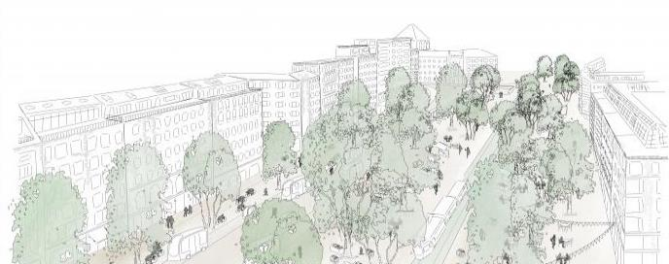
Thematic axis 1
Reconnecting with nature
The natural environment should not be thought of as separate to the built environment, and development programmes should treat nature as an integral part of the human environment.
Healthy co-existence with the natural world requires addressing multiple challenges in parallel, such as shifting to green mobility, “re-naturing cities”, and restoring biodiversity.
Environmental vulnerability is a threat to both urban and rural areas, proposed solutions may refer to permaculture or agroforestry, ‘smart villages’, sustainable tourism, and the integration of rural-urban dynamics.
Das Perivàllonistisch Manifest, Bavaria

Slide 13
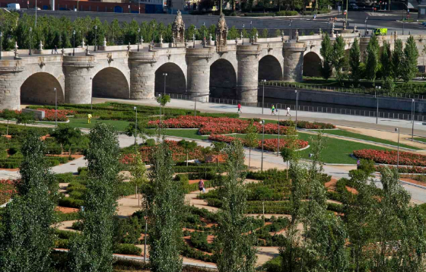
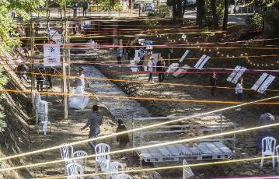
Thematic axis 2
Regaining a sense of belonging
In regions particularly affected by the green transition, it is important to not only focus on sustainability, innovation, and jobs, but also on community-building and cultural heritage.
A lack of cultural spaces and places to gather can negatively impact well-being.
Culture, art, and local knowledge play important roles in connecting people to the character and traditions of a place, which should not be overwritten by the green or digital transition.
Supporting local business and an ‘economy of proximity’.
Madrid Río Urban Transformation
The Rivers of Sofia Festival

Slide 14
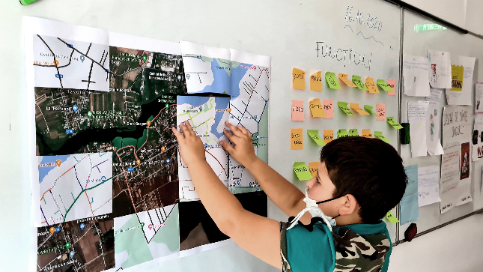
Thematic axis 3
Prioritising the places and people that need the most
Access to decision-making power in design should be open to all, and take into account the specific needs of different groups (with particular outreach to the elderly, the disabled, immigrants, and economically deprived territories).
There is a need to connect rural areas with cities, and bridge the digital divide.
Housing affordability must be enhanced and access to services, education, employment, green spaces, and infrastructures should be broadened.
De-a arhitectura, Romania

Slide 15
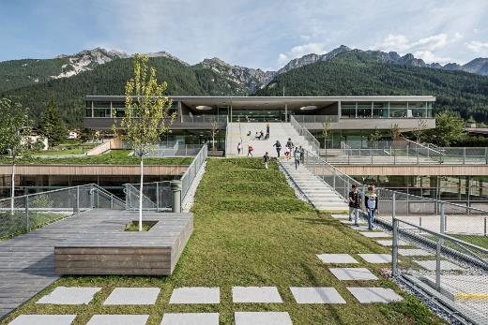
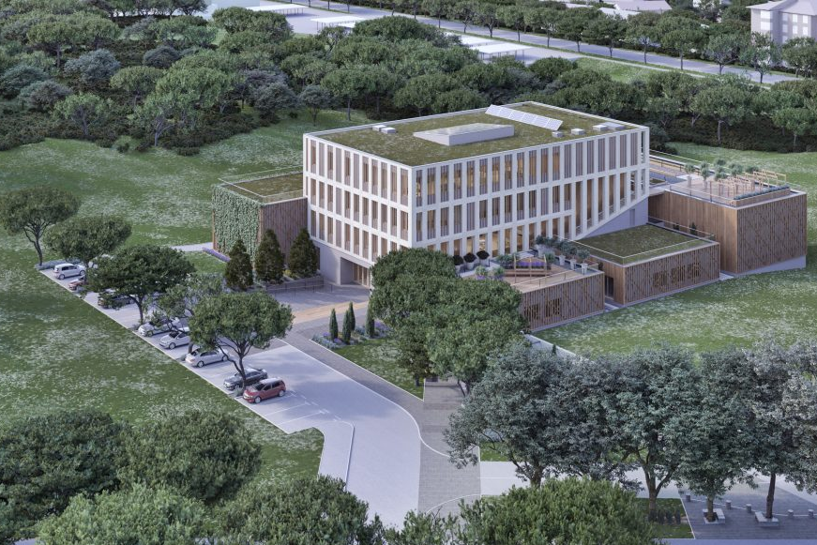
Thematic axis 4
Fostering long-term, life cycle, and circular thinking
There is an urgent need to tackle the unsustainable use of resources across industries, and move towards a circular economy.
For construction, the main message is to avoid demolition and new construction in favour of rehabilitation and adaptive re-use.
Taking advantage of nature-based solutions, materials, and skills is essential.
It is imperative to adapt the mentality around development to embrace a long-term perspective and life cycle thinking.
Schoolcampus Neustift, Tirol
InnoRenew CoE, Izola

Slide 16
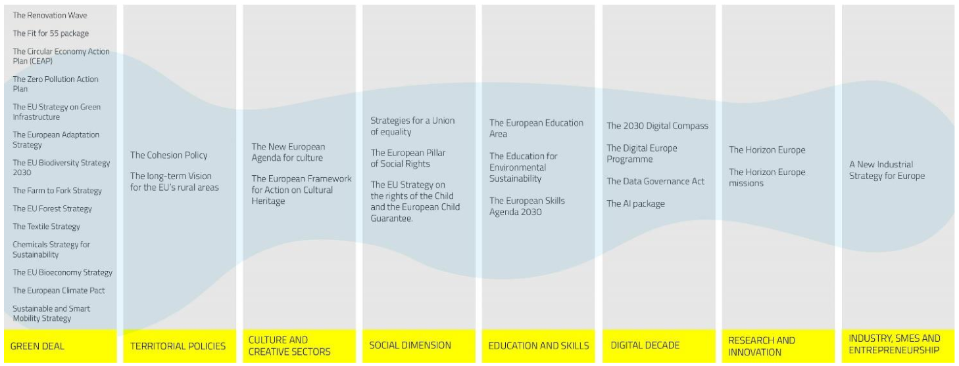
New European Bauhaus policy ecosystem

Slide 17
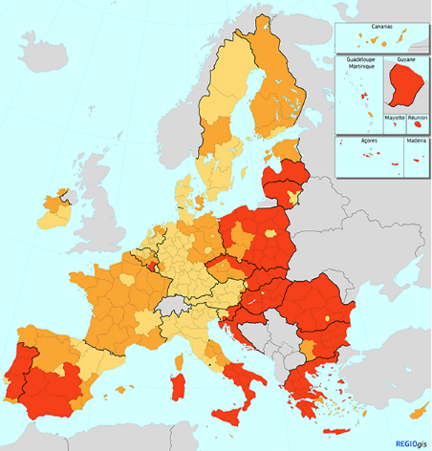
Role of cohesion policy
Concrete actions to contribute to NEB:
Technical assistance in capacity building
Investigating the enabling/inhibiting conditions for New European Bauhaus projects.
Identifying funding sources – including dedicated financial instrument (upcoming)
Developing sound processes underpinning co-design at the local level
Financing individual Bauhaus-suitable projects via existing funds

Slide 18
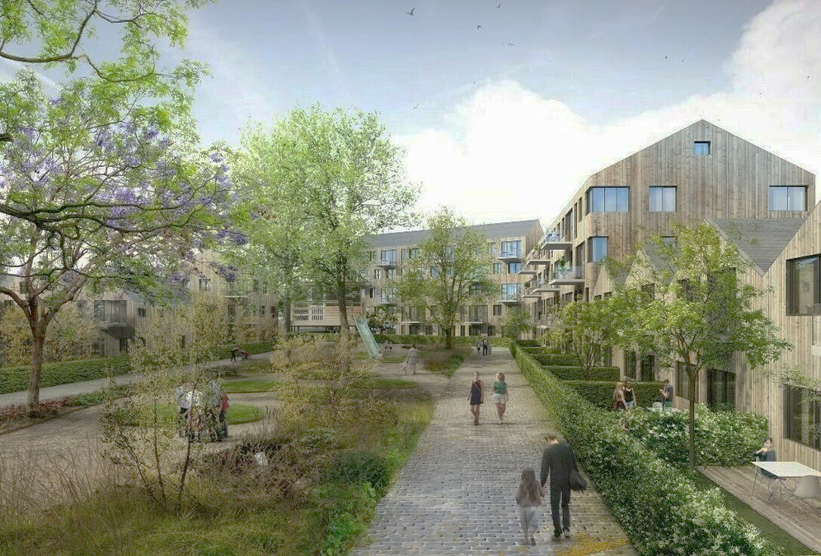
Next steps
Establish a point of contact between Slovenian authorities and DG REGIO
Potential for EC Technical Assistance actions 2022
Further technical meetings to discuss possible TA provision
Produce a Terms of Reference document based on local priorities
Consider NEB criteria in project selection
Expand the NEB network
Involve more stakeholders in the network of
NEB official partners

Slide 19
Initial thoughts on EC Technical Assistance actions for 2022
Contracting an independent expert to provide tailored support for ‘mainstreaming’ NEB principles into programmes and development strategies
Potentially by:
Developing concrete recommendations for an effective work approach
Reviewing relevant programmes and strategies and identifying where potential NEB projects can be smoothly implemented
Creating a ‘best practices’ guide to inform the integration of NEB principles into action (PA, OPs)

Slide 20





NEB official partners in Slovenia

Slide 21
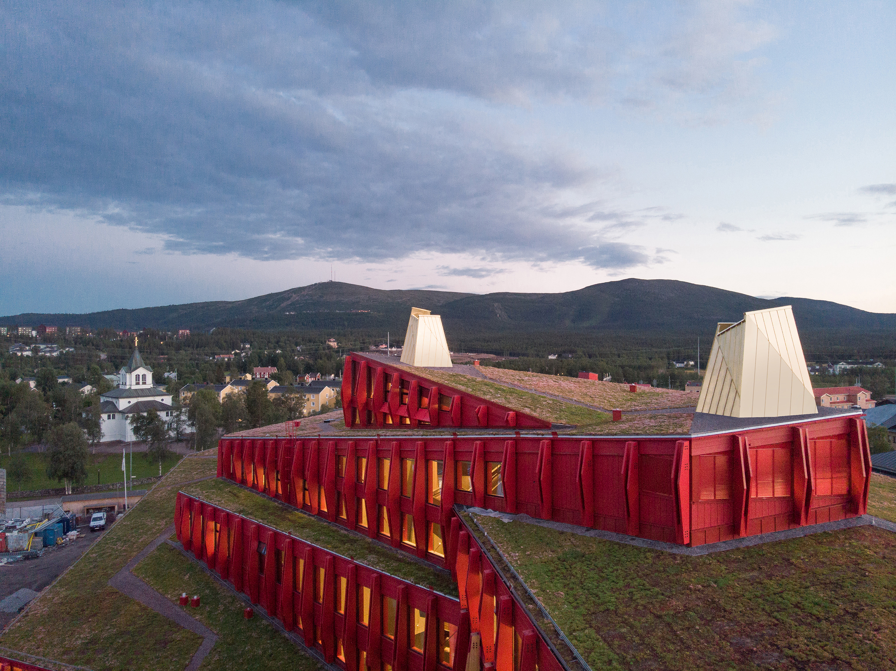
Questions:
Where does the programming under way in Slovenia have potential to embody NEB principles?
What do you foresee as potential constraints to apply these principles in practice?
How can DG REGIO (or the EC generally) better support you to implement NEB principles across your programming?

Slide 22
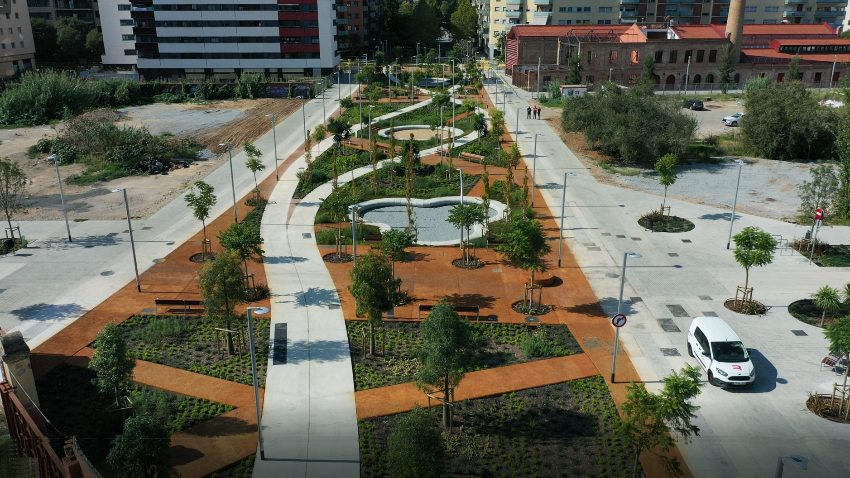
THANK
YOU!

