Slide 1


Making Missions Work: the TRAMI project
EMIN Meeting
addressed to
Strategic Configuration and EU Mission Subgroups
23. June 2023
Online
Wolfgang Polt (Joanneum Research POLICIES)
Matthias Weber (AIT Austrian Institute of Technology, Center for Innovation Systems and Policy)

Slide 2
Missions: Unterlying rationales
“If we can land a man on the moon, why can’t we solve the problems of the ghetto?” (Nelson 1977) → different types of missions (Kuittinen/Polt/Weber 2018):
    ‘accelerator’ (scientific, technological, economic)
    ‘transformative’ (large-scale socio-technical systems)
…“initiatives [which] … have clearly defined (societal or technological) goals with preferably qualified and/or quantified targets and progress monitored along predefined milestones. Directionality and intentionality of these initiatives is what differentiates them from other types of initiatives, such as systemic or challenge-oriented policies”
2
Notes:
Why are we reiterating this? (i) Because the understanding of what a mission is still not common (ii) because in trying to empirically define what are mission-oriented policies, instruments and funding streams, this is a major challenge

Slide 3
Implementing Missons ...
...a multitude of activities ...
Several activities have been launched to accompany the implementation of EU Missions: Mission-specific CSAs, Mutual Learning Exercises, Expert Groups etc. … and: TRAMI as cross-cutting project focusing on mission governance
Duration: 04/2022 – 04/2024
26 partners from 17 MS and AS, mostly public administrations and agencies tasked with the implementation of missions with the ambition of creating sustainable structures and processes to support the governance of mission implementation
3

Slide 4
Objectives
To support the alignment and coordination between national, regional and local initiatives
To exchange best practice on how national, regional and local efforts and related funding can contribute to missions’ objectives
To facilitate the engagement of regional and local actors in support of EU-level and national activities;
To map the relevant national, regional and local stakeholders (incl. civil society organisations and institutions) and funding streams
To prepare for potential hubs at national level
To develop the basis for a mission governance model
To raise awareness and to engage and mobilise key stakeholders and citizens to actively participate in EU Missions processes and activities
To build and consolidate a sustainable European Mission Core Network
To provide policy intelligence related to the missions
To promote knowledge exchange, mutual learning and dissemination and engagement of stakeholders
To engage and mobilise key stakeholders and citizens
…across the missions and governance levels
…with a view to build sustainable ‘infrastructures’
4

Slide 5
Creating formats for SUSTAINED learning and collaboration ...
EMIN
European Mission Network
Intended to be sustained and link to EU decision making processes
MAPPING
Data base and survey
MLE
Mutual Learning Events
Flexible, varying topics, user oriented / driven
EMIF
European Mission Forum
Addressing broader stakeholder groups
Monitor the implementation of the missions
5

Slide 6
Assessment of the
advancement of missions
„Mission readiness“ is uneven
No single best model
Need for alignment
STI and policy trap
  Some countries and regions have set up mission governance structures and programmes already; others only about to start
  Trajectories of national political systems matter; missions need to be embedded in and aligned with existing structures, institutions and initiatives, including pre-existing national missions
  Need for EU missions to be aligned and synchronised with pre-existing strategies, initiatives, and even missions on the national and regional leveland synchronization
  Mission-oriented policies need to go beyond STI policy (”whole of government”), and beyond policy circles. Involvement of business and citizens still to be strengthened in the individual missions.
6

Slide 7
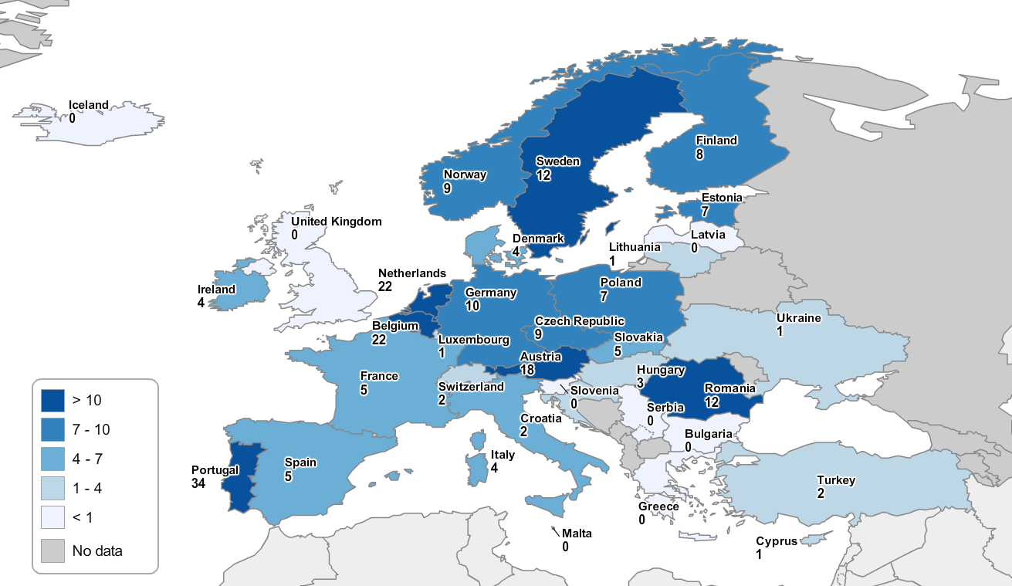
Online-Survey
Mapping
Mapping (Country Self Assessment): 16 Countries (Austria, Belgium, Czech Republic, Denmark, Estonia, Finland, Germany, Ireland, Luxembourg, Netherland, Poland, Portugal, Romania, Slovakia, Spain, Sweden)
Survey: Geographical background of respondents (Sample size n=210, 26 countries)

Slide 8
Assessment of the
advancement of missions
„Mission readiness“ is uneven
No single best model
Need for alignment
STI and policy trap
  Some countries and regions have set up mission governance structures and programmes already; others only about to start
  Trajectories of national political systems matter; missions need to be embedded in and aligned with existing structures, institutions and initiatives, including pre-existing national missions
  Need for EU missions to be aligned and synchronised with pre-existing strategies, initiatives, and even missions on the national and regional leveland synchronization
  Mission-oriented policies need to go beyond STI policy (”whole of government”), and beyond policy circles. Involvement of business and citizens still to be strengthened in the individual missions.
8

Slide 9
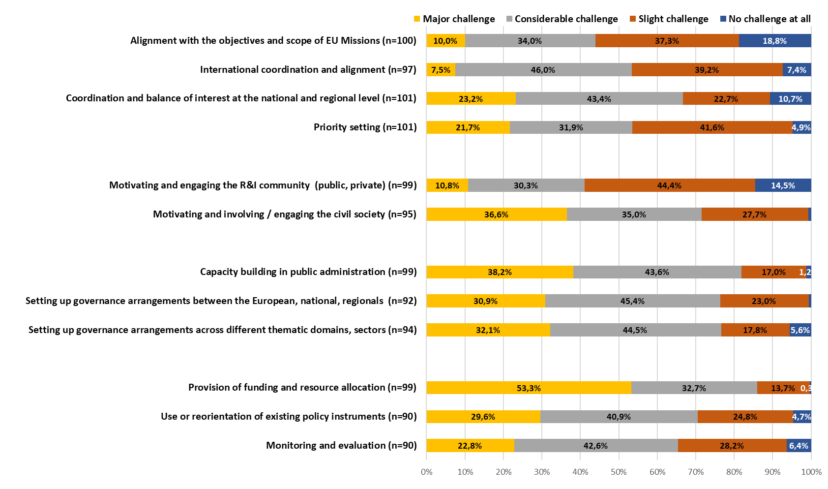
Challenges of the implementation of EU Missions (1)
Alignment,
pre-screening,
definition,
priority setting
Awareness and
Motivation
Notes:
The alignment to the EU missions or the motivation of research actors is seen as less of a challenge than
motivation the civil society and coordination and balancing of interests or the setting of priorities in the countries.
E.g. emphasized in France or Romania

Slide 10
Assessment of the
advancement of missions (2)
Good and promising practices emerging
Institutional capacity-building
Missions still receive too limited attention and funding
  Willingness of advanced countries and regions to share their innovative and promising experiences meets strong demand from other countries
  Building institutional capacities for mission governance (at strategic and operational levels) takes time.
  Attention to (longer term) missions overshadowed by pressing concerns over ’polycrises’. Not all missions convey a strong ”sense of urgency”
10

Slide 11
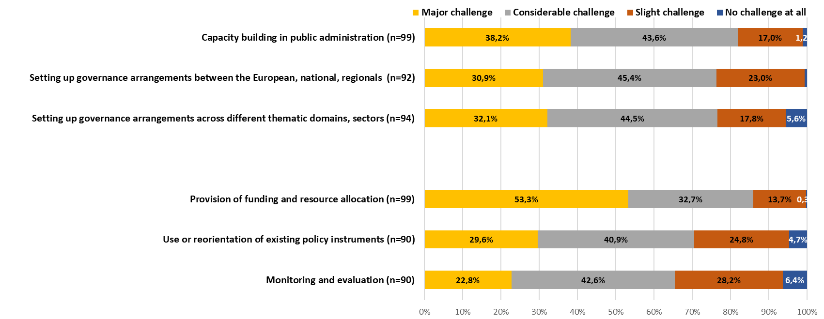
Challenges of the implementation of EU Missions (2)
Governance Structures and capacity
Dedication of national funding and adaptation of existing instruments
Notes:
The challenges in the implementation of the missions, starting from (already) existing foundations and structures, e.g..
Capacity building in administration is highlighted as a major challenge in Romania, France, the Czech Republic and Belgium, for example.
In countries with well-equipped funding systems, such as Finland or Sweden, the provision of funding or the use of existing
instruments is highlighted less as a challenge.

Slide 12
TRAMI activities of potential use for you
Join and actively support EMiN
  Regular meetings, events and information on missions in Europe
Participate and promote EMiF European Missions Forum 2024
  EMiF 2023 (31 January 2023) attended by ~1000 participants
  EMiF 2024 planned for March
Contribute to Mapping
  In focus: MS/AC beyond TRAMI members (country correspondents)
Initiate and participate in Mutual Learning Events
Help creating sustainable structures to support mission implementation (on national and EU level) beyond the duration of the project
12

Slide 13
Questions for discussion
Share your experiences with implementing the EU missions?
What are the key challenges?
Where do you see potential for further develoment of the missions?
How could TRAMI support you?
13

Slide 14
Upcoming events
EMIN
European Mission Network
Currently >135 Members
Register at www.trami5missions.eu
Give us feedback
Tell us what you need
Stay informed – check our Website
Participate in our activities
Help us build the EMiN by being an active member!
Recent Events on Governance of Missions, on the conceptual foundations of Missions, …
Upcoming: 23 June SPC Missions Subgroups (invitation only)
Upcoming: 5 July: Getting Citizens Engaged
open for all
Join us any time: @EMiN Coffee Chat - every 2nd Thursday of the month 9:00-10:00
Except in June, Wednesday -7th
14

Slide 15


To learn more about the project and its partners, visit our Website: www.trami5missions.eu
To learn more about EMiN
Website: https://www.trami5missions.eu/about-emin
Stay informed about current activities, suscribe to the TRAMI Newsletter (registration on the website)
Connect via LinkedIn (just look for #TRAMI)
wolfgang.polt@joanneum.at
matthias.weber@ait.ac.at

